Slide 1


CSS3, SASS, Bootstrap node setup & MVC
Nagaraju Katta

Slide 2

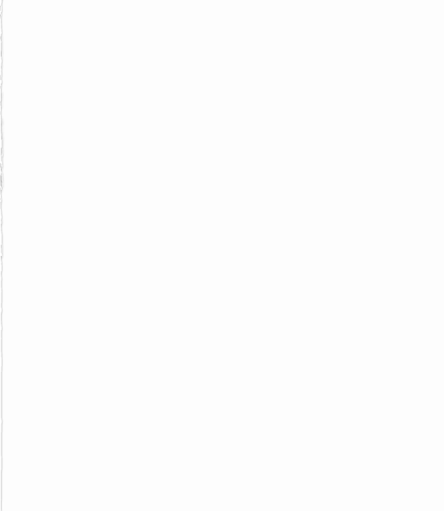
Today’s Agenda
What is CSS3
Introduction to SASS
Bootstrap NPM setup
Google Fonts
MVC Architecture

Slide 3
Web design
Webpage designing is one of the most popular verticals of web designing.
It defines how a website will display itself on the internet.
Various types of user experience also depend on this design.
Users must get attracted to the webpages to access it frequently.
The CSS is responsible for the styling part of the web design. It works in conjunction with HTML to provide a nice look, style, and structure to the program.

Slide 4
What is CSS?
The full form CSS is Cascading Style Sheet. It is a styling language used for designing web pages where we can structure the styles.
It is a stylesheet programming language used for describing the format and interface the elements of the markup language ( usually HTML) will take.
Hence CSS had become a significant part of web designing. Without the appearance, the web page’s entire look will become dull, and viewers will not find it notable to visit the page.
It not only provides desktop webpage styling features but also used for mobile web development

Slide 5
CSS vs CSS3
To make HTML-based web page development more aesthetic, in 1996, W3C ( World Wide Web Consortium) developed the Cascading Style Sheet.
They thought the presentation of the content should be powerful using layouts, colors, and fonts
CSS can accommodate background colors & images, line spacing, layout design, font style, display variation for different devices and screen sizes, and effects.
It is also essential to know the power and differentiation of CSS vs CSS3

Slide 6
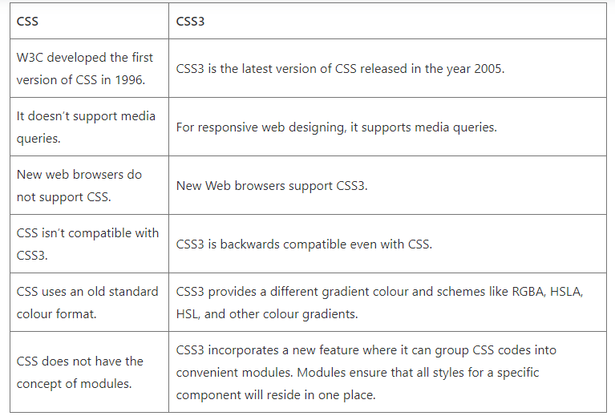

Slide 7
Technical aspects
Compatibility
There is a compatibility issue of CSS with CSS3.
All the preliminary CSS features got updated in CSS3. But CSS3 is backward compatible, and any code written in CSS is considered valid in CSS3.
CSS3 is efficient, and hence it makes loading time much faster.
Attribute Selector
CSS3 comes with the Selector concept, which was not there in CSS.
Rather than applying classes or IDs for creating styles, using CSS3, developers can pick HTML elements in place of IDs and classes as attributes to apply CSS styles

Slide 8
Introduction to SASS
In short, Sass is a CSS preprocessor, which adds special features such as variables, nested rules etc.
The aim is to make the coding process simpler and more efficient.

Slide 9
CSS preprocessor
A CSS preprocessor is a scripting language that extends CSS by allowing developers to write code in one language and then compile it into CSS.
Sass is perhaps the most popular preprocessor around right now, but other well-known examples include Less and Stylus

Slide 10
What is Sass?
Sass ( which stands for ‘Syntactically awesome style sheets) is an extension of CSS that enables you to use things like variables, nested rules, inline imports and more.
It also helps to keep things organized and allows you to create style sheets faster.
Sass is compatible with all versions of CSS.

Slide 11
Syntax
Sass included two syntax options:
SCSS ( Sassy CSS) : uses the .scss file extension and is fully compliant with CSS syntax
Indented ( simply called ‘Sass’): Uses .sass file extension and indentation rather than brackets; it is not fully compliant with CSS syntax, but it’s quicker to write
Note: Files can be converted from one syntax to the other using the sass-convert command

Slide 12
Variables
Just like other programming languages, Sass allows the use of variables that can store information you can use throughout your style sheet.
For example, you can store a color value in a variable at the top of the file, and then use this variable when setting the color of your elements.
This enables you to quickly change your colors without having to modify each line separately.

Slide 13
Nesting
Nesting is a double-edged sword. While it provides an excellent method for reducing the amount of code you need to write, it can also lead to over-qualified CSS if not executed carefully.
The idea is to nest your CSS selectors in such a way as to mimic your HTML hierarchy.

Slide 14
Partials
Partials are smaller Sass files that can be imported into other Sass files.
Think of partials as code snippets. With these code snippets, your CSS can now be modular and easier to maintain.
A partial is designated as such by naming it with a leading underscore: _partial.scss

Slide 15
Import
Used with Partials, the @import directive allows you to import your partial files into the current file, to build one single CSS file.
Note: When importing partials, you don’t need to include the file extension or the underscore.
E.g : _reset.scss
@import ‘reset’;

Slide 16
Extend/Inheritance
The @extend directive has been called one of Sass most powerful features.
The idea is that with this directive you won’t have to include multiple class names on your HTML elements and can keep your code DRY ( don’t repeat yourself).
Your selectors can inherit the styles of other selectors, and then be easily extended when required.

Slide 17
Operators
Having the ability to perform calculations in your CSS allows you to do more, like convert pixel values into percentages.
We have access to standard math's functions like addition, subtraction, multiplication and division. Of course, these functions can be combined to create complex calculations.
In addition, Sass included a few built-in functions to help manipulate numbers.
Functions like percentage(), floor() and round() to name a few.

Slide 18
Bootstrap NPM setup

Slide 19
Google Font’s

Slide 20
MVC architecture
MVC known as an architectural pattern, which embodies three parts Model, View and Controller.
It divides the application into three logical parts; the model part, the view and the controller.
It was used for desktop graphical user interfaces but nowadays it used in designing mobile apps and web apps.

Slide 21
History
Trygve Reenskaug invented MVC. The first reports on MVC were written when he was visiting a scientist at Xerox Palo Alto Research Laboratory (PARC) in 1978/79.
At first, MVC was called “Thing Model View Editor” but rapidly changed it to “ Model View Controller”.
The goal of Tygrve was to solve the problem of users controlling a large and complex data set.
The practice of MVC has changed over the years.
Since the MVC pattern was invented before web browsers, initially was used as an architectural pattern for graphical user interfaces(GUI).

Slide 22
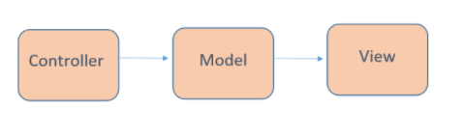
The original MVC

Slide 23
Currently MVC it’s used for designing web applications.
Some web frameworks that use MVC concept: Ruby on Rails, Laravel, Zend framework, CherryPy, Symphony, etc

Slide 24
MVC Architecture
MVC is an architectural pattern which means it rules the whole architecture of the applications.
Even though often it is known as design pattern but we may be wrong if we refer it only as a design pattern because design patterns are used to solve a specific technical problem, whereas architecture pattern is used for solving architectural problems, so it affects the entire architecture of our application.

Slide 25
Three main components
It has three main components and each of them has specific responsibilities.
The main reasons why MVC is used are:
First, it doesn't allow us to repeat ourselves
Second, it helps to create a solid structure of our web applications

Slide 26
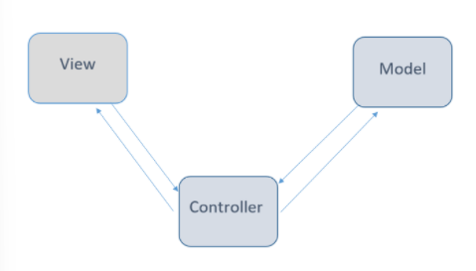

Slide 27
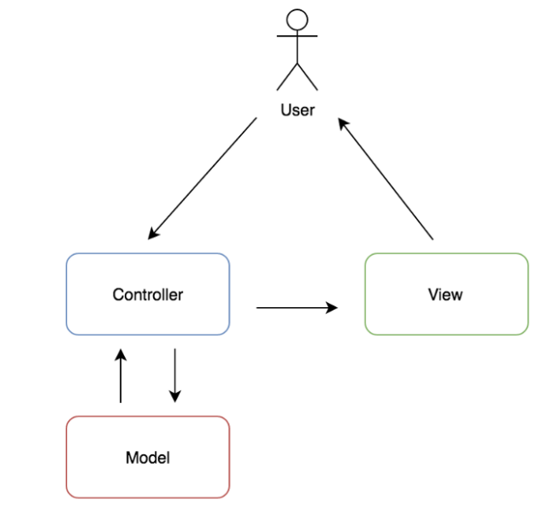

Slide 28
Model
It is known as the lowest level which means it is responsible for maintaining data.
Handle data logically so it basically deals with data. The model is actually connected to the database so anything you do with data. Adding or retrieving data is done in the model component.
It responds to the controller requests because the controller never talks to the database by itself.
The model talks to the database back and forth and then it gives the needed data to the controller.
Note: the model never communicated with the view directly.

Slide 29
View
Data representation is done by the view component. It actually generates UI or user interface for the user..
So at web applications when you think of the view component just think the Html/CSS part.
Views are created by the data which is collected by the model component but these data aren’t taken directly but through the controller, so the view only speaks to the controller.

Slide 30
Controller
It’s known as the main man because the controller is the component that enables the interconnection between the views and the model so it acts as an intermediary.
The controller doesn’t have to worry about handling data logic, it just tells the model what to do.
After receiving data from the model it processes it and then it takes all that information it sends it to the view and explains how to represent to the user.
Note: Views and models can not talk directly.

Slide 31
Advantages of MVC
MVC architecture will separate the user interface from business logic
Components are reusable.
Easy o maintain.
Different components of the application in MVC can be independently deployed and maintained.
This architecture help to test components independently.

Slide 32
Disadvantages of MVC
The complexity is high.
Not suitable for small applications.
The inefficiency of data access in view.

Slide 33
So MVC is not that easy to understand, it’s really hard actually, but not impossible to learn and every developer needs to keep it in mind when developing an application.
Just keep in mind that MVC is an architecture that divides your software into smaller components.
The model deals with data and the logic of your system.
The view only displays data and the controller maintains the connection between the model and the view.
This ‘division’ enables readability and modularity as well it easier the testing part.

Slide 34
Home work
Understand and Build MVC in Vanilla JavaScript
Ref: https://www.sitepoint.com/mvc-design-pattern-javascript/
Read and give examples of built-in functions in Sass
Read about mixins in Sass

